Slide 1

MYLEGION OVERVIEW:
Register a MyLegion Account
Register a MyLegion account to review membership details, update contact and demographic information, print membership card, and manage user account.
2025
Notes:
Register a MyLegion account to review and manage membership details.

Slide 2
ABOUT MYLEGION
One account provides online membership details and resources for TAL and SAL members. All accounts are individual.
Post and Squadron membership is accessed through the individual MyLegion account. Adjutants and Commanders of posts, squadrons, districts and counties have access to TAL and SAL membership when reported to department/detachment headquarters.
Email must be on your membership record on file at National HQs. Registering with an email not listed as your primary email will not provide access to membership details or leadership resources.
Notes:
One MyLegion account provides online access to membership details and resources for American Legion and Sons of the American Legion members.
<1> Post and Squadron membership is accessed through your individual MyLegion account. Adjutants and commanders of posts, squadrons, districts and counites have access to TAL and SAL membership when reported to department/detachment headquarters.
<2> The Email used during registration must be on your membership record on file at National HQs. Registering with an email not listed as your primary email will not provide access to membership details or leadership resources.

Slide 3

BEFORE YOU REGISTER
Do you have an email address on your membership record?
Contact your local or department leadership
to verify or add the email address on your
membership record.
Registering an account with an email not on
your record will create an account with no membership details.
Notes:
Before registering an account, you may want to verify your email address is correct on your membership record with your <1> squadron or department leadership. All MyLegion accounts are to be registered with the primary email address. <2> Registering without the email on your membership record will create an account with no member details.

Slide 4
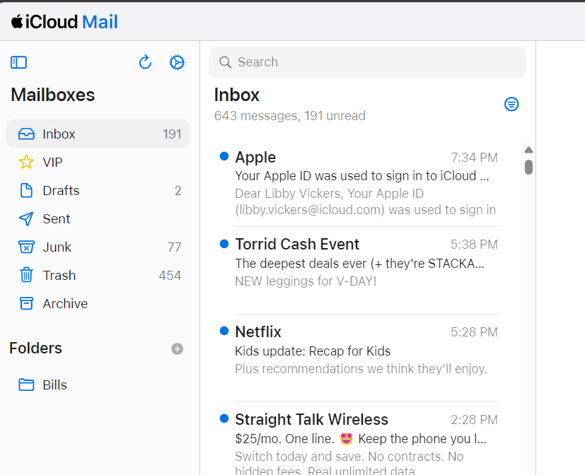
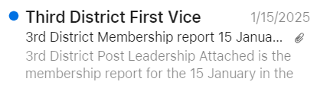
BEFORE YOU REGISTER
Email browser should be open to receive a one-time password (OTP) during registration.
Notes:
Have your email browser open and ready to receive an email. During registration, a one-time password will be sent to complete the last step of registration with email verification.

Slide 5
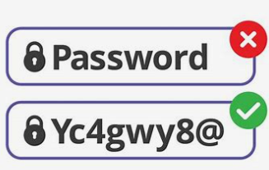
BEFORE YOU REGISTER
Be prepared to create a password that meets the requirements below:
One Uppercase Letter
One Lowercase Letter
One Number
One Symbol (!@#$%^&*)
Eight character minimum
Notes:
Be prepared to create a password. Password requirements include: <3> 1 Uppercase letter, 1 Lowercase letter, 1 Number, 1 symbol, and have an eight (8) character minimum.

Slide 6
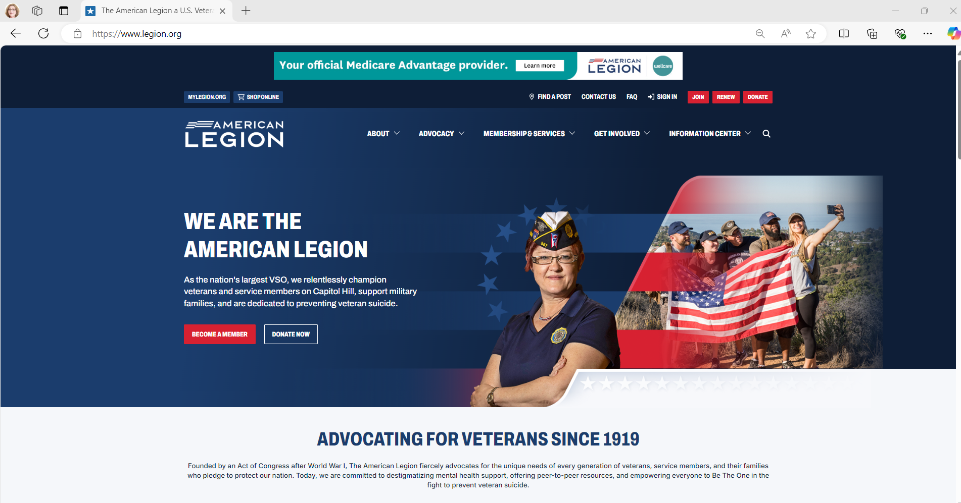

LEGION.ORG
Notes:
The American Legion National website is legion.org. Located at the top of the page is a link for MyLegion. <1>

Slide 7
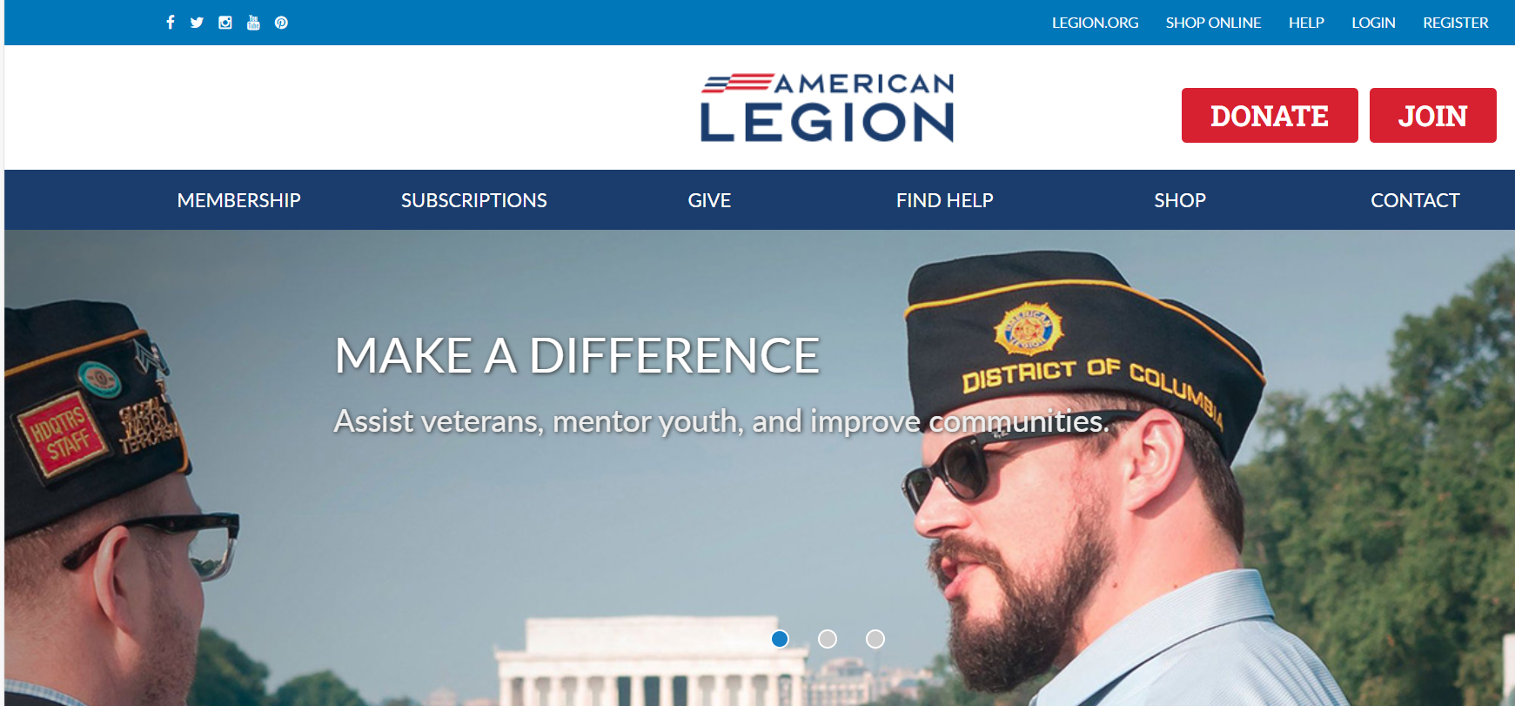
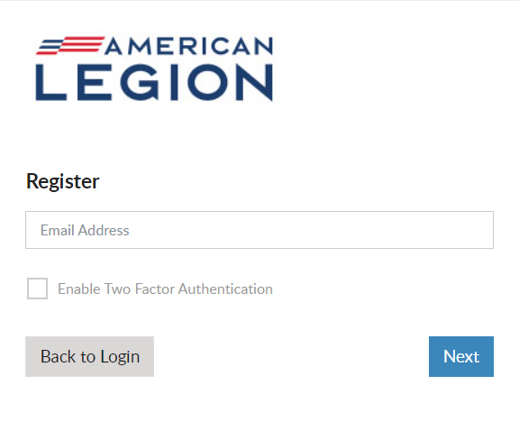
Notes:
In the upper right, click Register. Notice, there may be additional places to access the same tool. Log in and register is also located in the middle of the page. Begin registration by entering your primary email address.
<1> All MyLegion accounts are to be registered with the email address on your membership record.
<2> Two-factor authentication is an extra layer of security to ensure that you're the only person who can access your account, even if someone knows your password. This extra security measure requires you to verify your identity using a randomized code we’ll email you each time you attempt to log in. Applying this feature is available when you first create your account. It can be added or removed later through your account.
<3> Enter your email address and click Next.

Slide 8
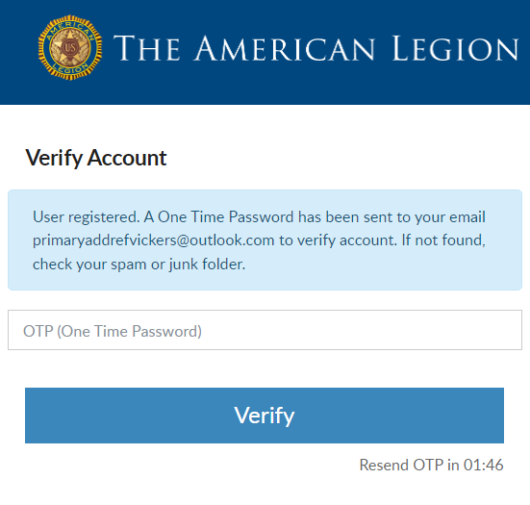
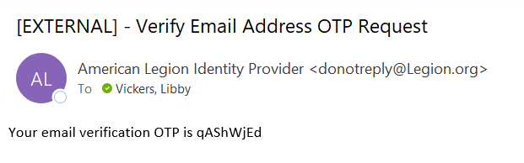

VERIFY ACCOUNT
Do not close this window. Go to your email to retrieve the OTP.
2 minutes to complete.
Notes:
You will be asked to verify you have access to the email address.
Do not close this window. Return to your email to retrieve a one-time password. <1> This message comes from The American Legion Identify Provider. Check your Spam or Junk folders if you do not see the message within 10-15 seconds. The email will be sent immediately. <2> There is a 2-minute time period to enter the one-time password and verify. It the time expires you will see a message to request another OTP. This step ensures that you have access to the email address associated with this account.

Slide 9
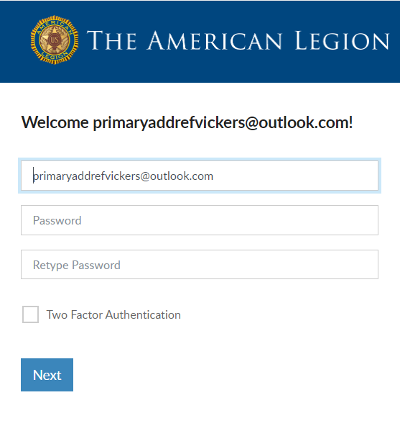
USERNAME AND PASSWORD
Username defaults to email address.
Create Password.
Two Factor Authentication.
Password Requirements:
Uppercase Letter
Lowercase Letter
Number
Symbol (!@#$%^&*)
8-character Minimum
Notes:
Members will receive a welcome window to complete the final step, create a password.
The username defaults to the email address entered. It is recommended to leave the email address as your username. However, you can update the username in this window by updating it in the Username field. When creating a username, try to use something unique.
<1> Create a password using the following criteria: 1 upper and lowercase letter, 1 number, 1 symbol or special character and a minimum of 8 characters in total.
<2> You do have another chance to add two factor authentication.
<3> Click “Next” to proceed.

Slide 10
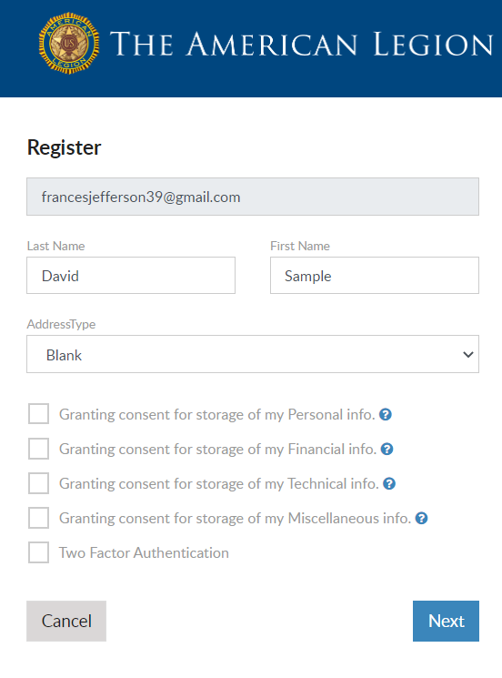



CAUTION
LGN and SAL members do not proceed if you receive this window.
Email entered does not match what is on member record.
Contact local or state leadership to verify email on file.
primaryaddrefvickers@outlook.com
Notes:
Members of The American Legion and Sons of the American Legion should not proceed if this window appears. Continuing will not connect to your membership details.
<1>The email address entered, must match what is on file at national headquarters. Members should Double check how the email address was entered. Was it entered correctly? If not, cancel and try again. <2> If it is entered correctly, click Cancel and contact your local or state leadership or national customer service to update your primary email address.

Slide 11
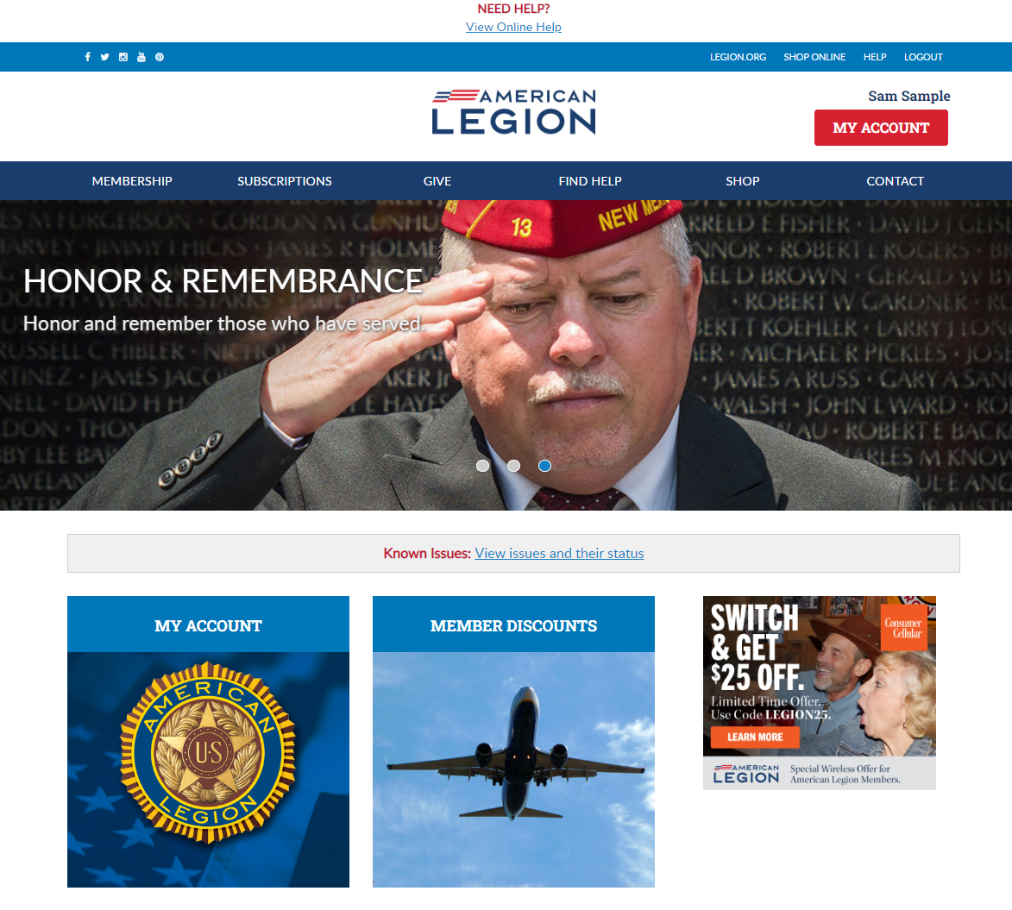
Notes:
Successful registration opens the MyLegion Home page that displays your name.
To view membership details and manage your account click on My Account. <1>
Leadership seeking post and squadron membership will access that information through My Account.

Slide 12
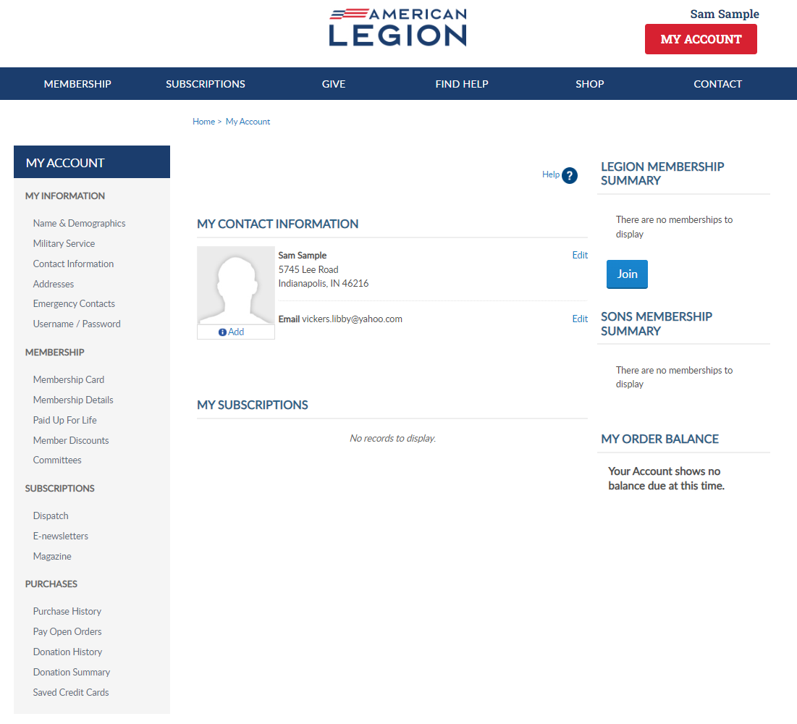
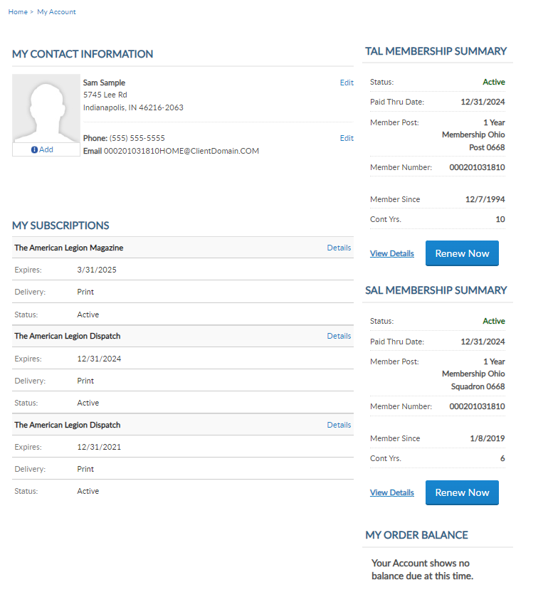
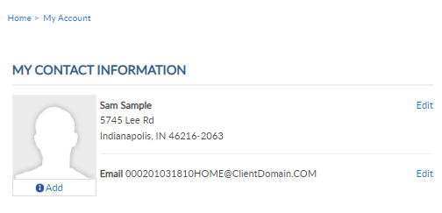
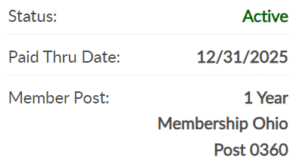
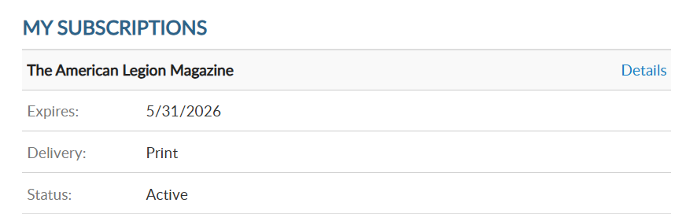

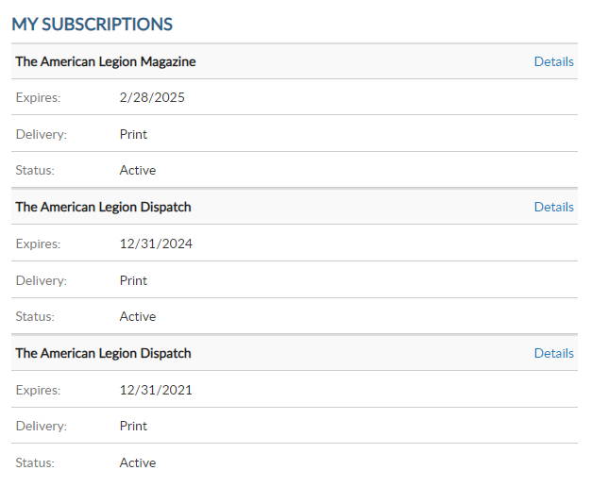
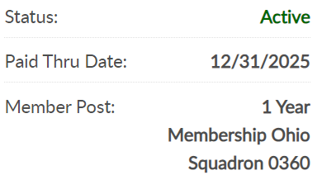

000123456789
PrimaryEmailAddress.com
000123456789
Notes:
My Account provides information on file at Department and National Headquarters.
Members of both Legion and SAL, also known as dual members, will have the same membership ID#. <1>
The membership summary also includes status, paid through date, renewal type, join date, and continuous years.

Slide 13
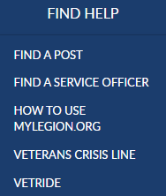
000123456789
PrimaryEmailAddress.com
000123456789
Notes:
Online help is available from the top Menu “Find Help”.
Step by step instructions, videos and training presentations will assist with how to manage your membership.

Slide 14
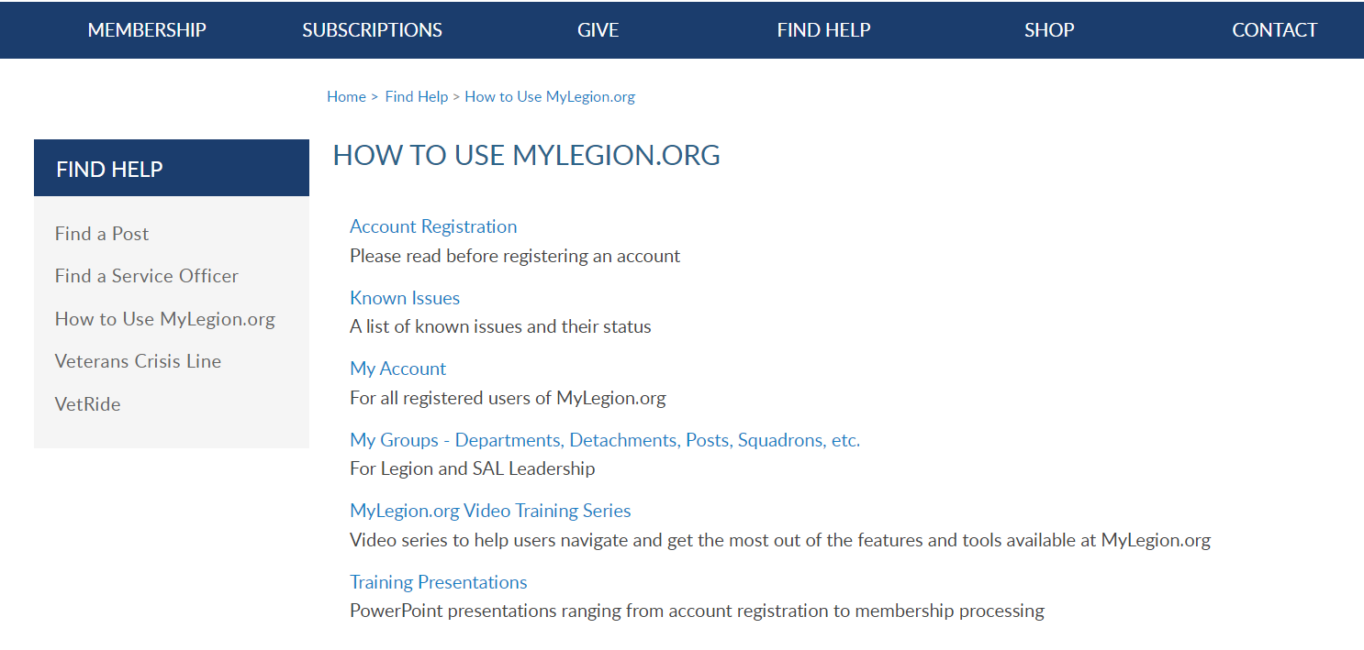
Online Help
Notes:
Step by step instructions, videos and training presentations will assist with how to manage groups in MyLegion. My Groups instructions include managing membership, online, membership processing, reports and all other administrative tasks.

Slide 15
MYLEGION SUPPORT
MyLegion@legion.org
833.253.9995
Monday – Friday
8:00am – 4:30pm
(Eastern)
The American Legion National HQs
5745 Lee Road
Indianapolis, IN 46216
Contact your MyLegion support team to assist with any questions or tools on your MyLegion account.
Notes:
Contact your myLegion support team to assist with questions and tools for MyLegion. Email mylegion@legion.org or call 833-253-9995 Monday through Friday.

